Slide 1
Analysis of hotel booking demand
CHI WANG a1810064

Slide 2
Dataset
The dataset was collected from two different hotel over Portugal which contain the demand data form 1/7/2015 to 31/8/2017.
10,000+ rows and 30 columns.
It includes the reservation information of city hotel and resort hotel, such as reservation time, stay time, the number of adults/children/infants, and the number of available parking spaces etc.

Slide 3
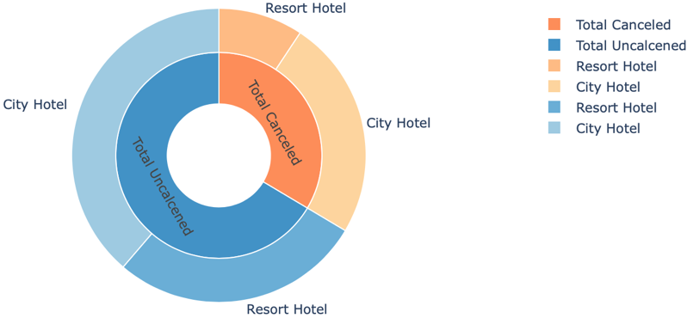
Which hotel do people prefer to stay in?

Slide 4
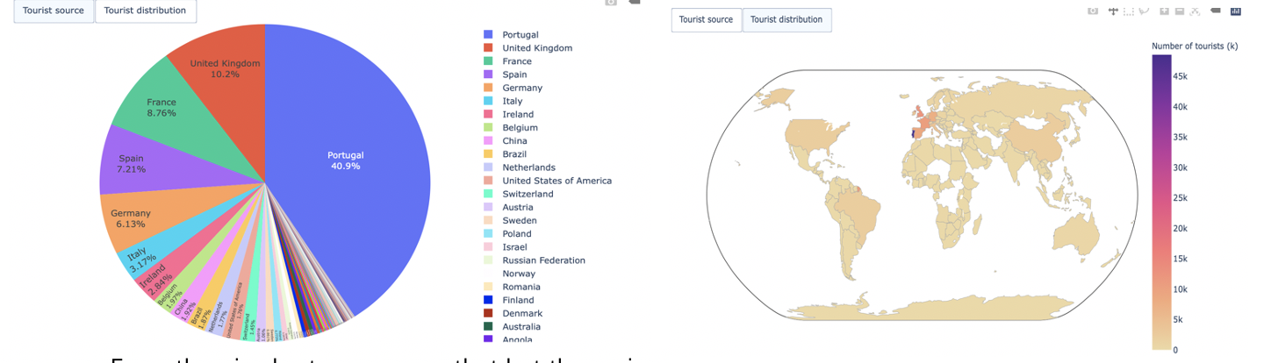
Where are the guests from?

Slide 5
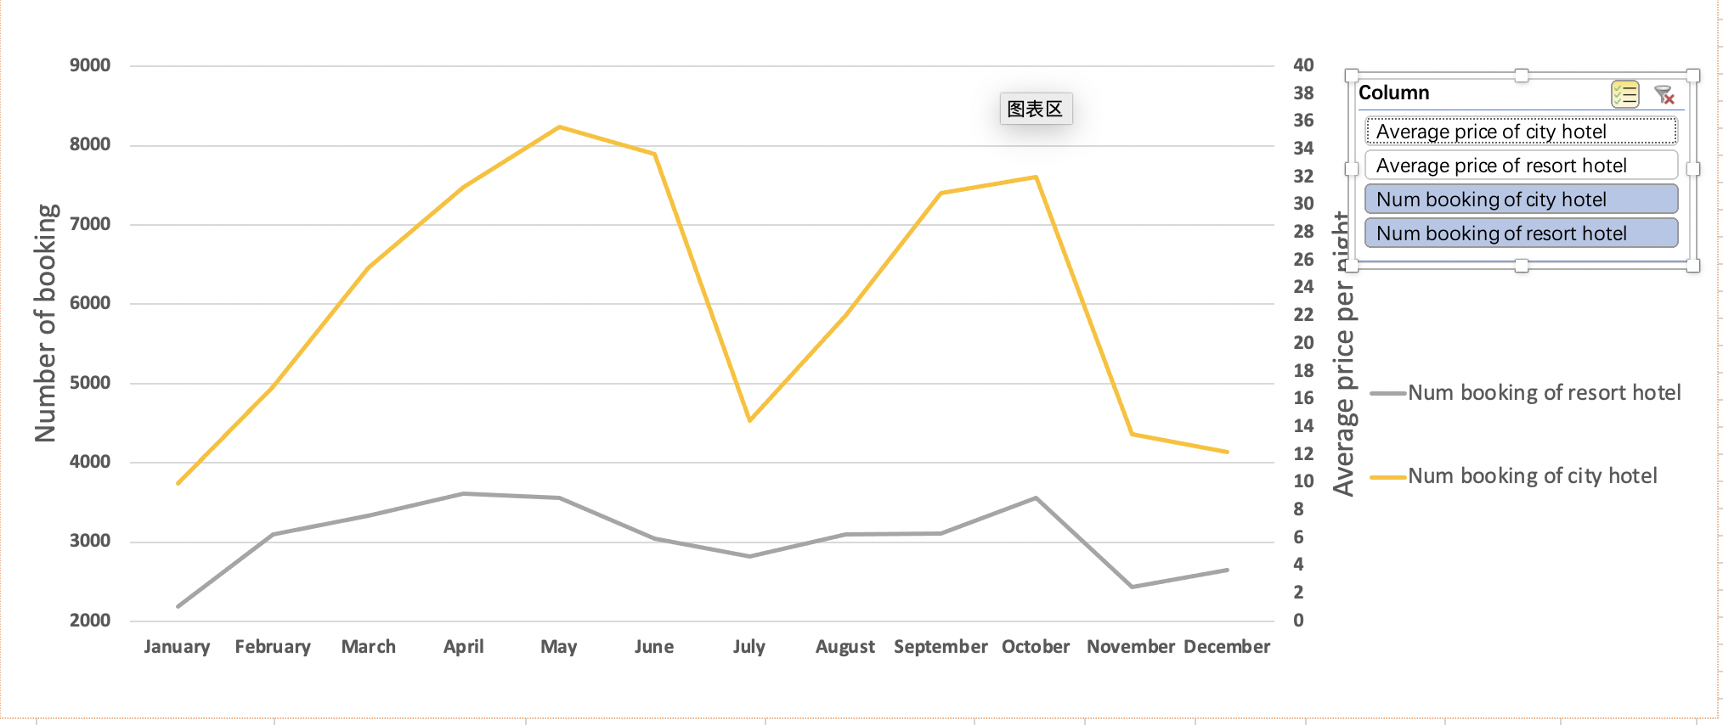


What are the booking quantities and prices in different months?

Slide 6
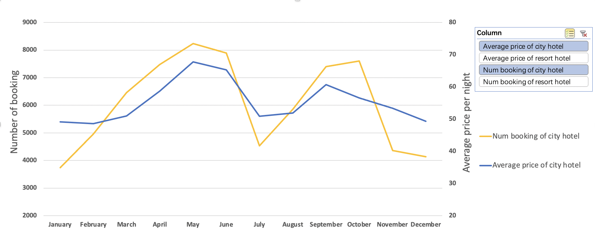
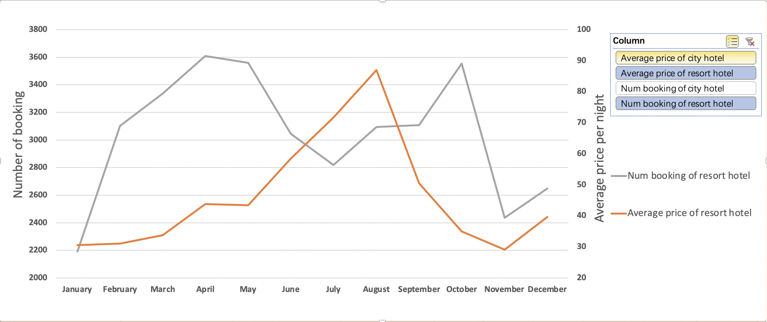
Price trend and number of booking of city hotel
Price trend and number of booking of resort hotel

Slide 7
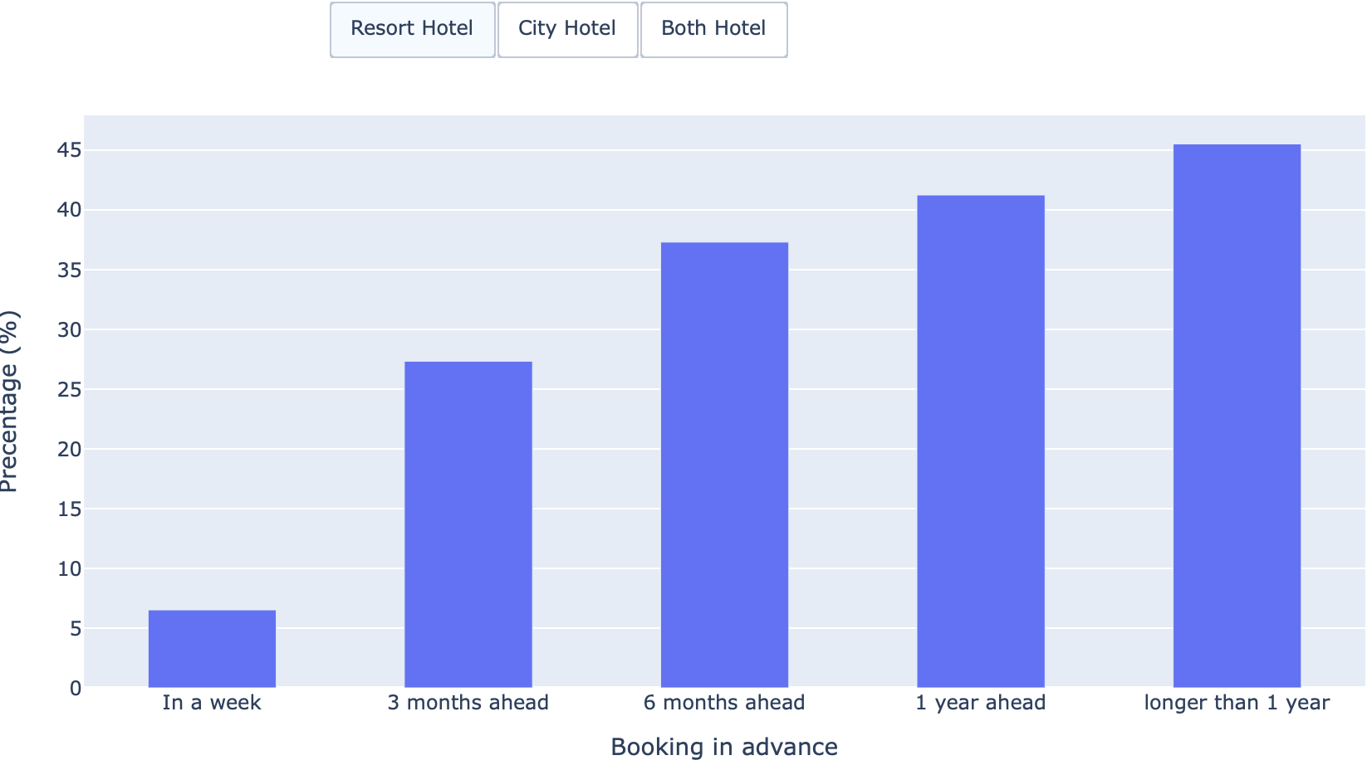
Will booking in advance affect the cancellation rate?

Slide 8
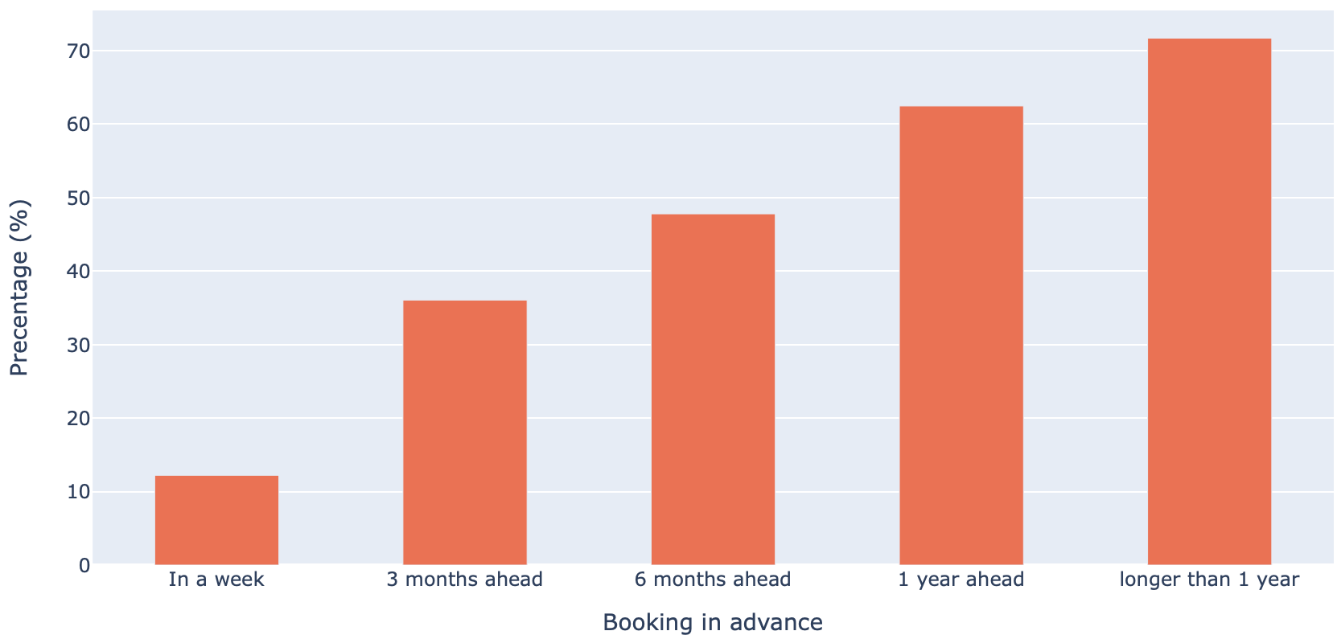
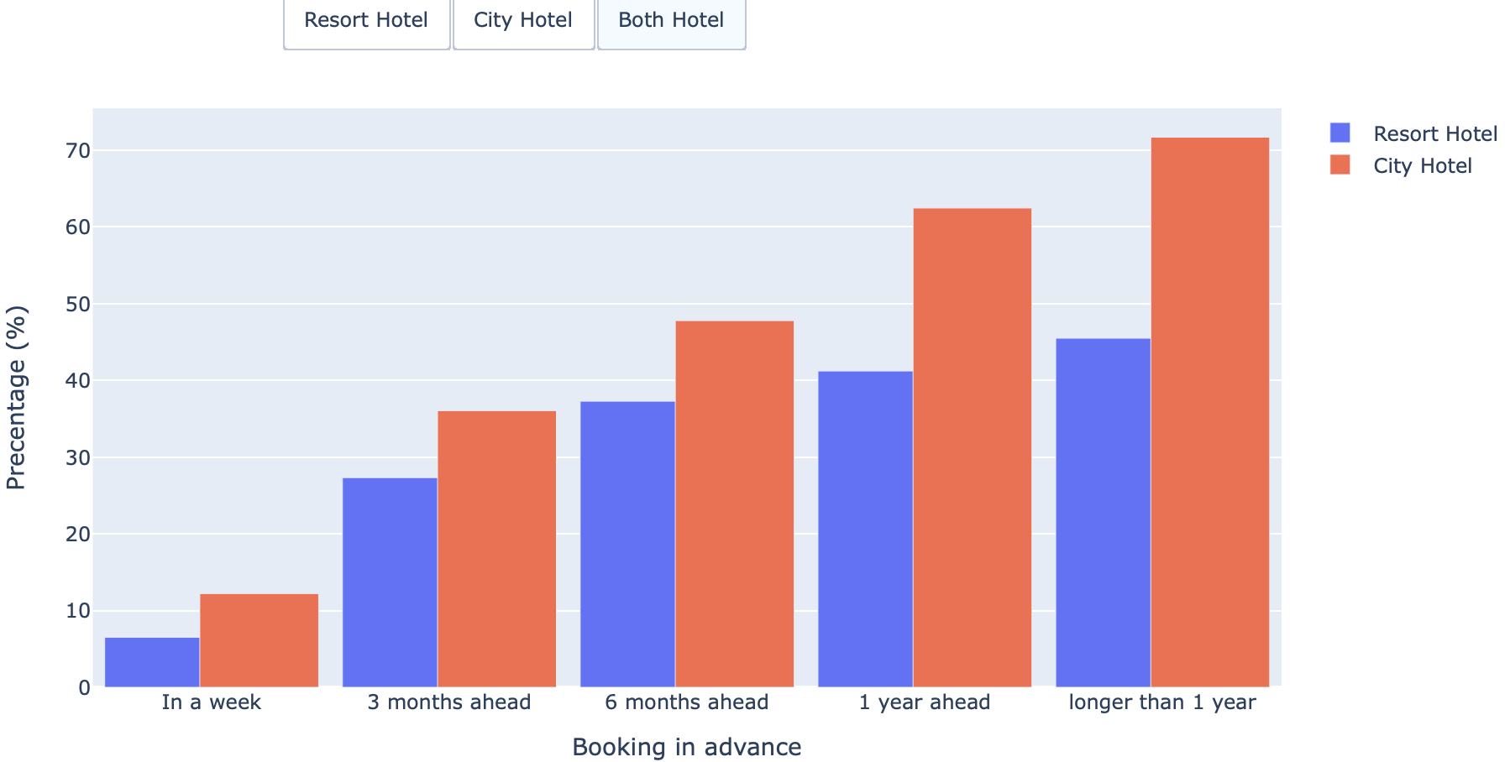
Cancel rate of resort hotel
Cancel rate of both hotels

Slide 9
Conclusion
People prefer to book city hotels, and city hotels have a higher cancellation rate
The main source of tourists is in Europe, and there are also many tourists from other continents.
People prefer to book the hotel in spring and summer and the price not always match the demand trend.
In the spring and autumn seasons, although the price of city hotels is high, the number of occupants has not decreased at all.
The longer booking in advance the higher cancellation rate

